Slide 1

7th Grade Math
Unit 12, Lesson 5 Volume of Right Circular Cylinders – Part 2 Volume 2, pg. 217

Slide 2


Benchmark
MA.7.GR.2.3
Solve mathematical and real-world problems involving volume of right circular cylinders.
volume 2, pg. 217

Slide 3
Integrated Mathematical Thinking and Reasoning Standards
MA.K12.MTR.1.1 Actively participate in effortful learning both individually and collectively.
MA.K12.MTR.3.1 Complete tasks with mathematical fluency.
MA.K12.MTR.4.1 Engage in discussions that reflect on the mathematical thinking of self and others.
MA.K12.MTR.6.1 Assess the reasonableness of solutions.
MA.K12.MTR.7.1 Apply mathematics to real-world contexts.
volume 2, pg. 217

Slide 4

Learning Target
I can find the volume of a right circular cylinder.
volume 2, pg. 217

Slide 5

Warm-Up
volume 2, pg. 218

Slide 6
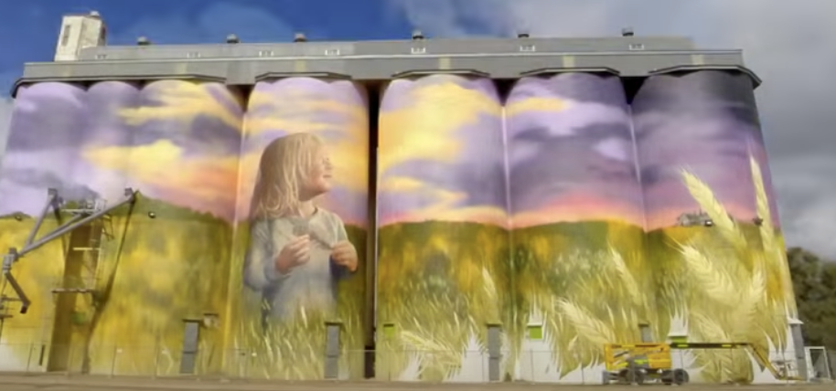
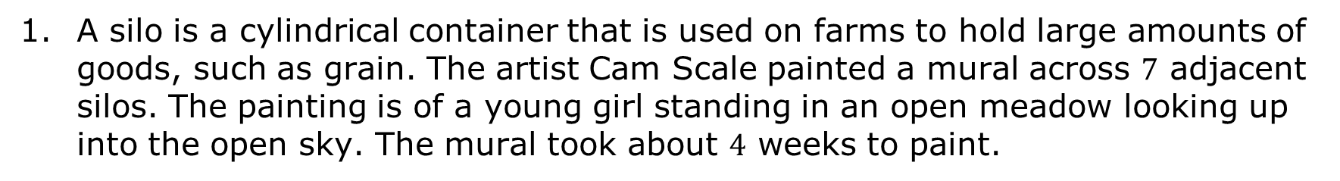
12.5.1 Warm-Up: What Do You Wonder?
A silo is a cylindrical container that is used on farms to hold large amounts of goods, such as grain. The artist Cam Scale painted a mural across $7$ adjacent silos. The painting is of a young girl standing in an open meadow looking up into the open sky. The mural took about $4$ weeks to paint.
volume 2, pg. 218

Slide 7
Describe at least two steps you think the artist needed to take before painting this mural.
What is something you wonder about this artist’s project?
volume 2, pg. 218

Slide 8

Guided Instruction
volume 2, pg. 218

Slide 9
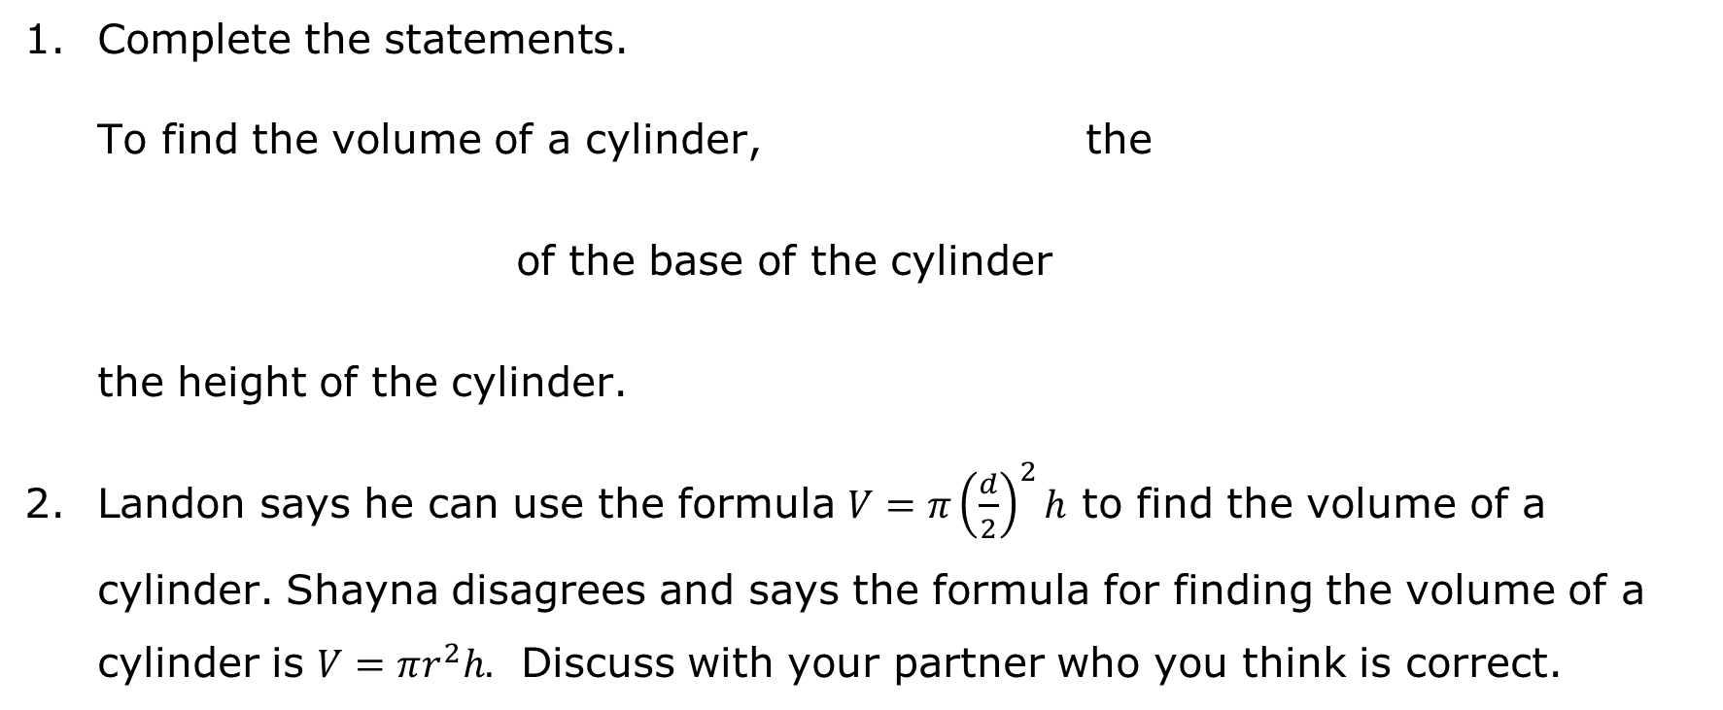
12.5.2 Guided Instruction: Finding the Volume of a Right Circular Cylinder
Complete the statements.
To find the volume of a cylinder, the of the base of the cylinder
the height of the cylinder.
Landon says he can use the formula $V=π{\left(\frac{d}{2}\right)}^{2}h$ to find the volume of a cylinder. Shayna disagrees and says the formula for finding the volume of a cylinder is $V=πr^{2}h.$ Discuss with your partner who you think is correct.
add
multiply
area
circumference
to
by
volume 2, pg. 218

Slide 10
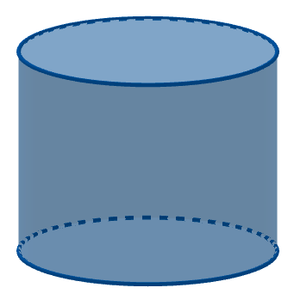
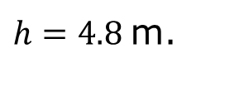

The cylinder shown has a diameter of $6$ meters (m.) and a height of $4.8$ m.
$d=6$ m.
$h=4.8$ m.
volume 2, pg. 219

Slide 11
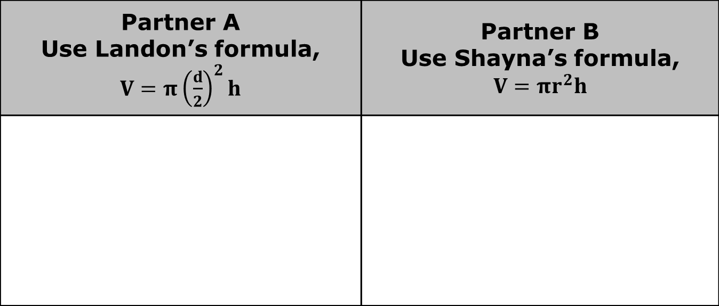
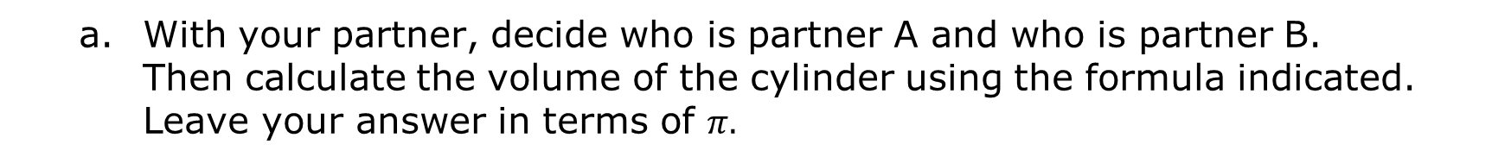
With your partner, decide who is partner A and who is partner B. Then calculate the volume of the cylinder using the formula indicated. Leave your answer in terms of $π.$
Partner A Use Landon’s formula, $V=π{\left(\frac{d}{2}\right)}^{2}h$ | Partner B Use Shayna’s formula, $V=πr^{2}h$
volume 2, pg. 219

Slide 12
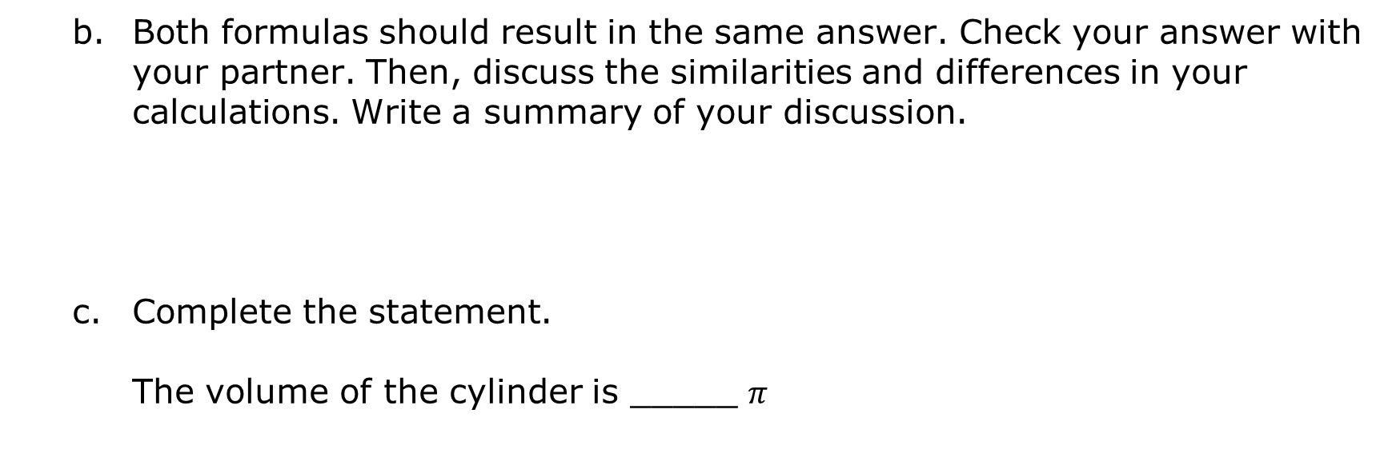
Both formulas should result in the same answer. Check your answer with your partner. Then, discuss the similarities and differences in your calculations. Write a summary of your discussion.
Complete the statement.
The volume of the cylinder is _____ $π$
m.
m².
m³.
volume 2, pg. 219

Slide 13
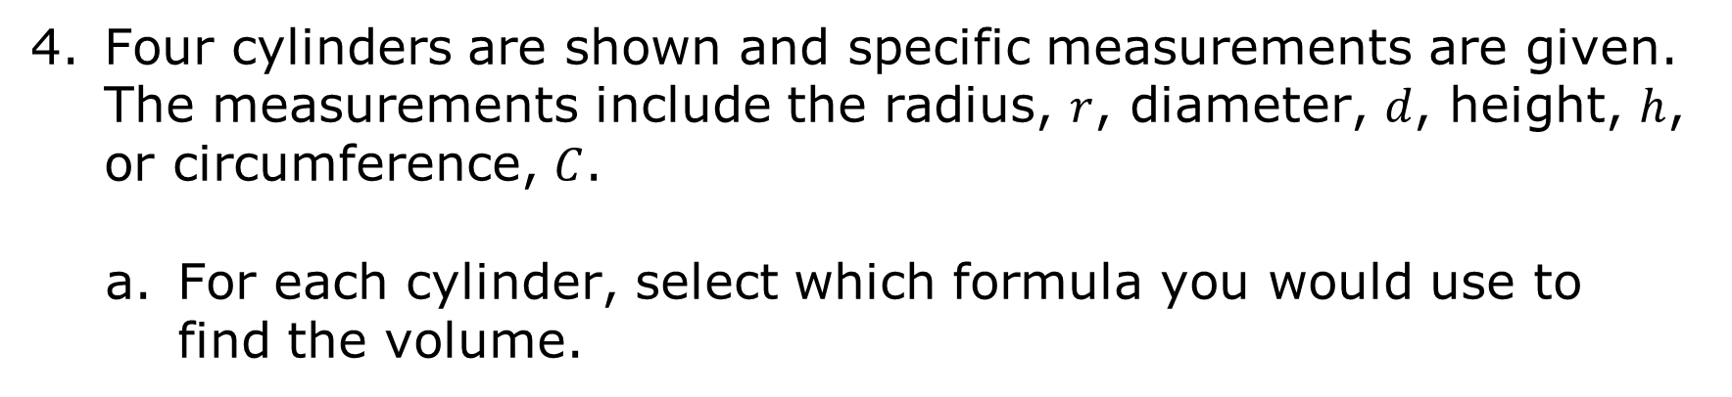
Four cylinders are shown and specific measurements are given. The measurements include the radius, $r$, diameter, $d$, height, $h$, or circumference, $C$.
For each cylinder, select which formula you would use to find the volume.
volume 2, pg. 219

Slide 14
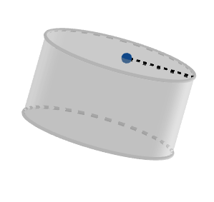
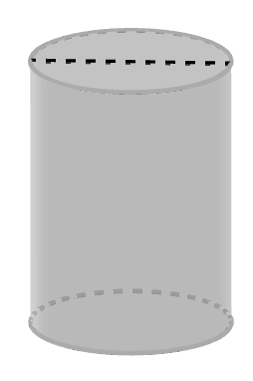

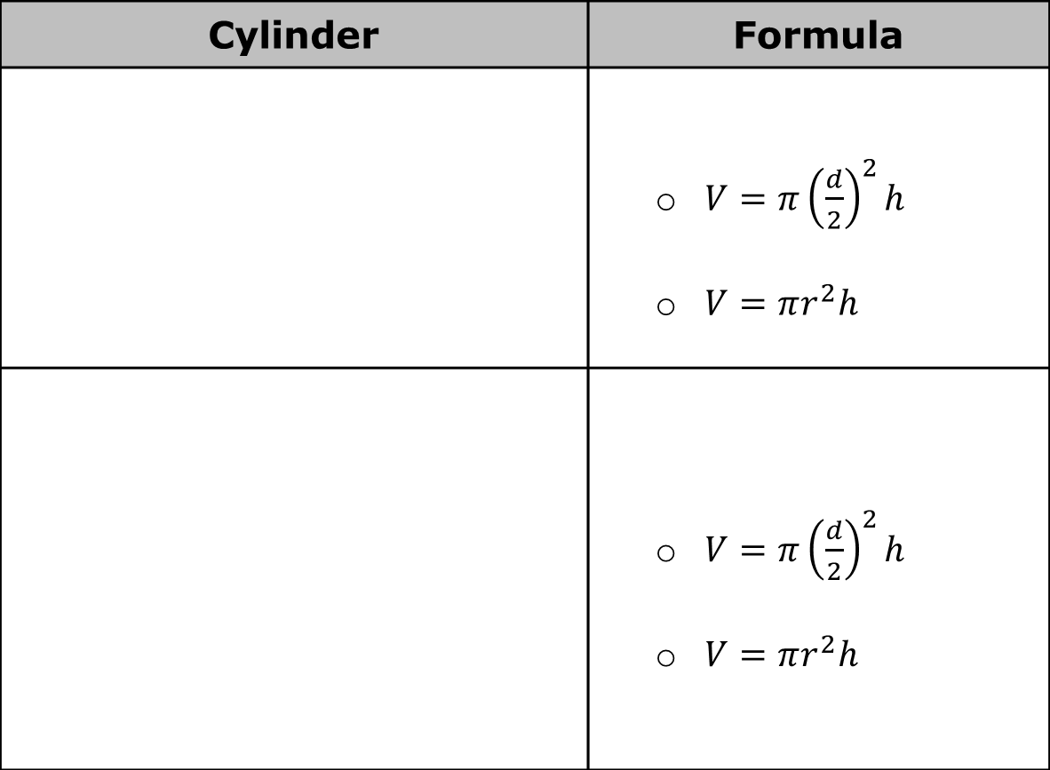



Cylinder | Formula
 | $V=π{\left(\frac{d}{2}\right)}^{2}h$ $V=πr^{2}h$
 | $V=π{\left(\frac{d}{2}\right)}^{2}h$ $V=πr^{2}h$
$r=3$ in.
$h=5$ in.
$d=3$ cm.
$h=11$ cm.
volume 2, pg. 219

Slide 15
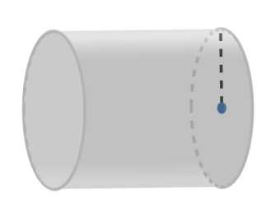
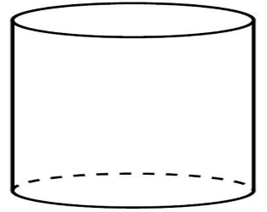



Cylinder | Formula
 | $V=π{\left(\frac{d}{2}\right)}^{2}h$ $V=πr^{2}h$
 | $V=π{\left(\frac{d}{2}\right)}^{2}h$ $V=πr^{2}h$
$h=4.1$ m.
$r=2$ m.
$C=6π$ units
$h=10$ units
volume 2, pg. 219

Slide 16
Either formula can be used to calculate the volume of a cylinder. Compare your selections above with your partner. Discuss your reasoning for each selection.
volume 2, pg. 220

Slide 17

Guided Practice
volume 2, pg. 220

Slide 18

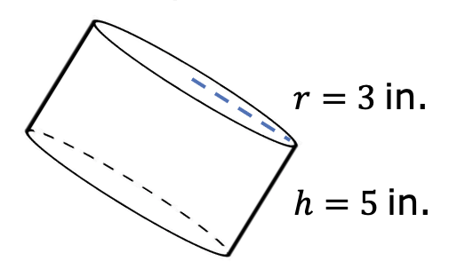
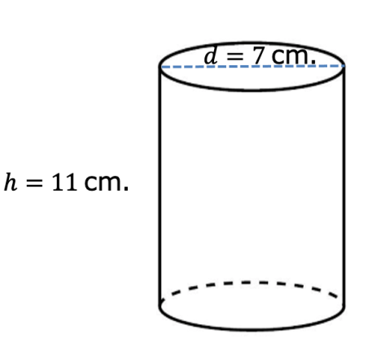
12.5.3 Guided Practice: Using Diameter or Radius to Find the Volume of a Right Circular Cylinder
Calculate the volume of each right circular cylinder. Leave your answers in terms of $π$.
volume 2, pg. 220

Slide 19

On Mrs. Scarham’s farm, there is a silo with a height of $28$ feet (ft.) and diameter of $12$ ft.
Draw a sketch of the silo and label the dimensions.
How many cubic feet of grain can this silo hold? Use $3.14$ for $π$.
volume 2, pg. 221

Slide 20

Collaboration
volume 2, pg. 221

Slide 21

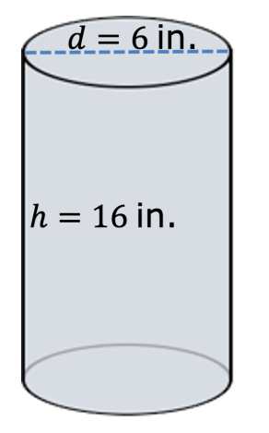
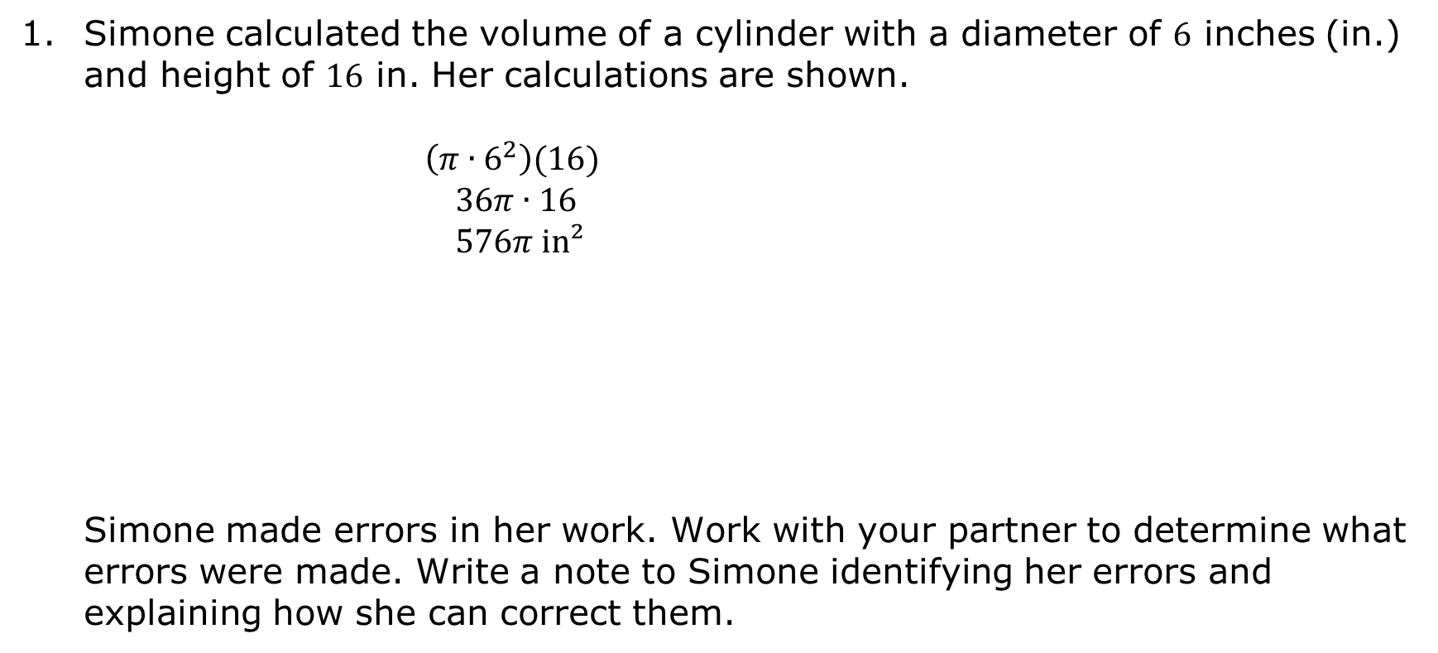
12.5.4 Collaboration: Error Analysis
Simone calculated the volume of a cylinder with a diameter of $6$ inches (in.) and height of $16$ in. Her calculations are shown.
$\left(π∙6^{2}\right)(16)$
$36π∙16$
$576π$ in²
Simone made errors in her work. Work with your partner to determine what errors were made. Write a note to Simone identifying her errors and explaining how she can correct them.
volume 2, pg. 221

Slide 22

Your Turn
volume 2, pg. 222

Slide 23
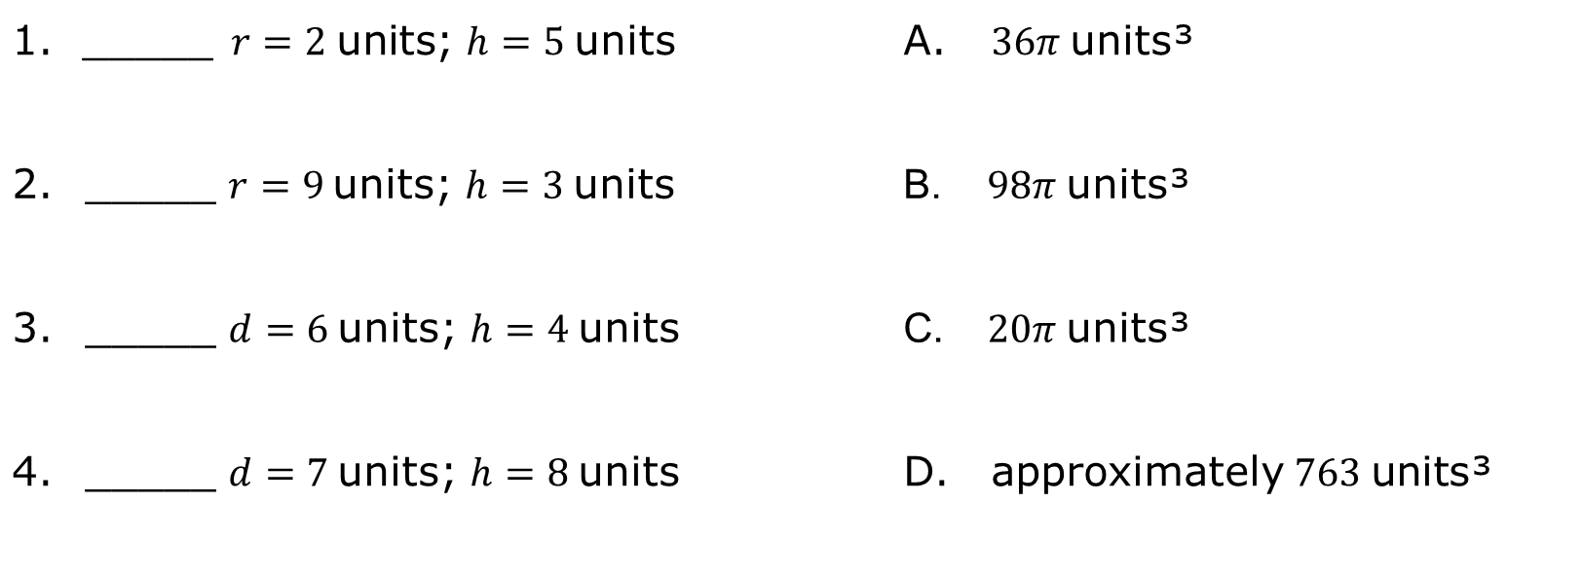
12.5.5 Your Turn!
The dimensions of four cylinders are given in the column on the left. Match each set of dimensions with the corresponding volume of the cylinder.
_____$r=2$units; $h=5$units | $36π$units³
_____ $r=9$units; $h=3$units | $98π$units³
_____ $d=6$units; $h=4$units | $20π$units³
_____ $d=7$units; $h=8$units | approximately$763$units³
volume 2, pg. 222

Slide 24
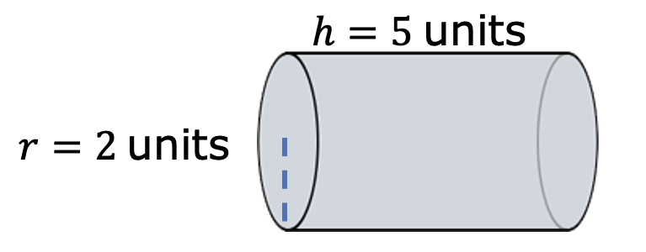
Find the volume of the cylinder shown. Use $\frac{22}{7}$ for $π$. Round your answer to the nearest thousandth.
volume 2, pg. 222

Slide 25
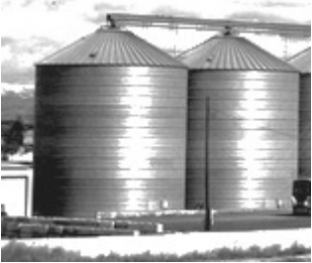
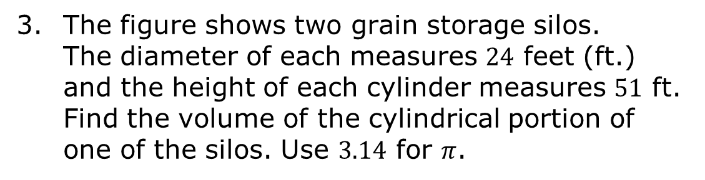
The figure shows two grain storage silos. The diameter of each measures $24$ feet (ft.) and the height of each cylinder measures $51$ ft. Find the volume of the cylindrical portion of one of the silos. Use $3.14$ for $π$.
volume 2, pg. 222

Slide 26

Wrap-Up
volume 2, pg. 223

Slide 27
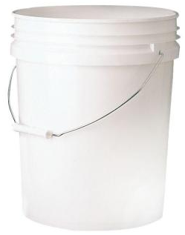
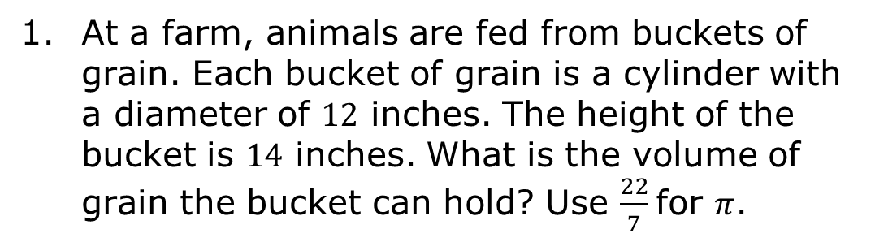
12.5.6 Wrap-Up: Ticket Out the Door
At a farm, animals are fed from buckets of grain. Each bucket of grain is a cylinder with a diameter of $12$ inches. The height of the bucket is $14$ inches. What is the volume of grain the bucket can hold? Use $\frac{22}{7}$ for $π$.
volume 2, pg. 223

